Slide 1
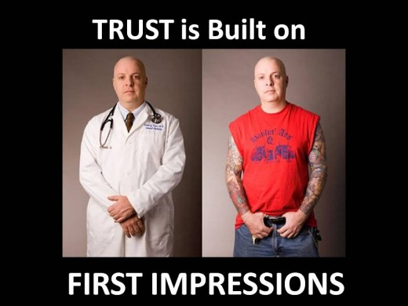
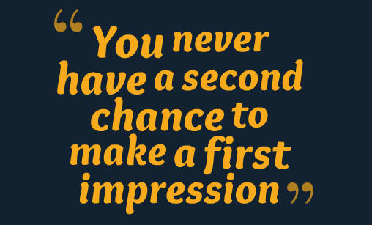
Why making a good impression is important?

Slide 2


Phone interview
Personal interview

Slide 3
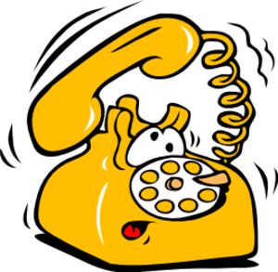
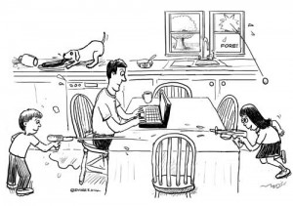
During phone interview
Eliminate distractions

Slide 4


During phone interview
Have reference materials nearby

Slide 5

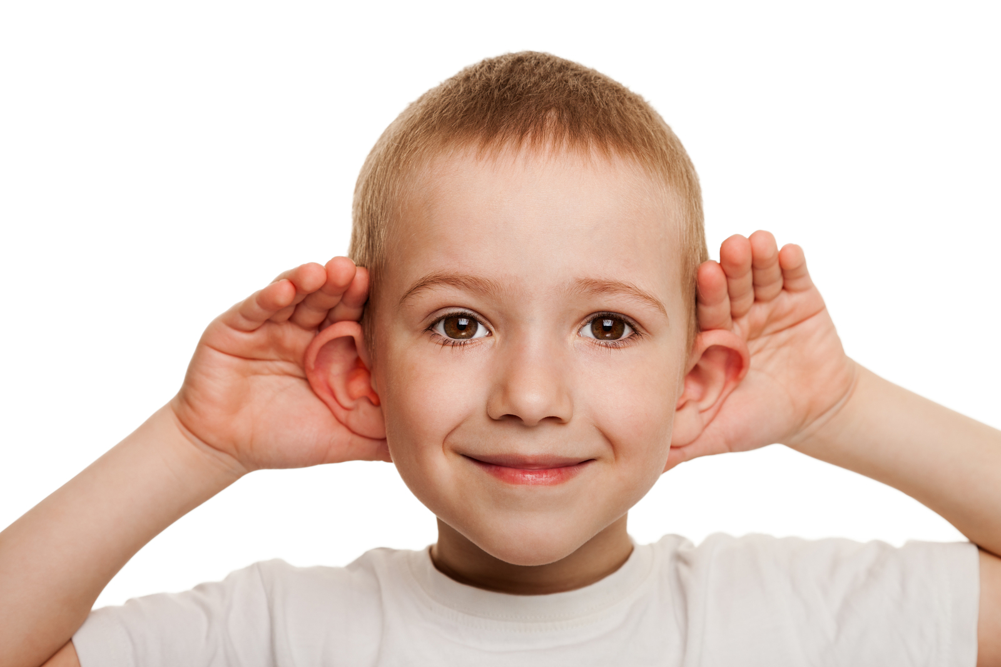
During phone interview
Focus, listen and enunciate

Slide 6
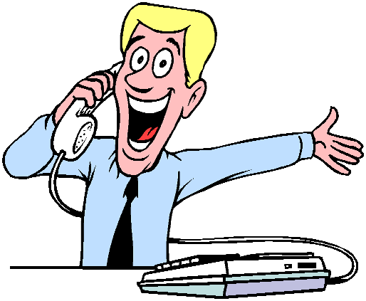
During phone interview
Be all smiles

Slide 7
Personal communication
words
voice, tone
body language
Notes:
7% - use of words
38% use of tone of voice
55%- use of body language
As per Albert Mehrabian (born 1939 in an Armenian family in Iran), currently Professor Emeritus of Psychology

Slide 8

Personal interview

Slide 9





Before personal interview
Dress appropriately
Bring only the essentials, organize to be accessible
Show up on time
Do a Pre-Interview Body check, put phone away

Slide 10
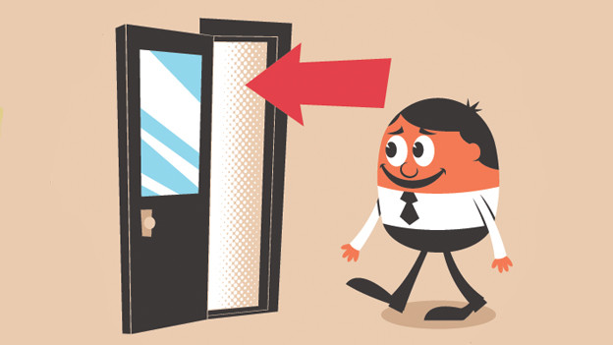
During personal interview
Entering confidently

Slide 11

During personal interview
Handshake and eye contact

Slide 12
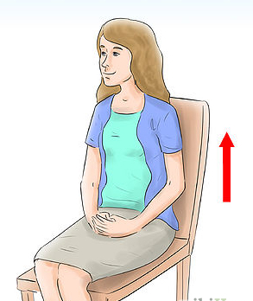

During personal interview
Posture and gesture

Slide 13

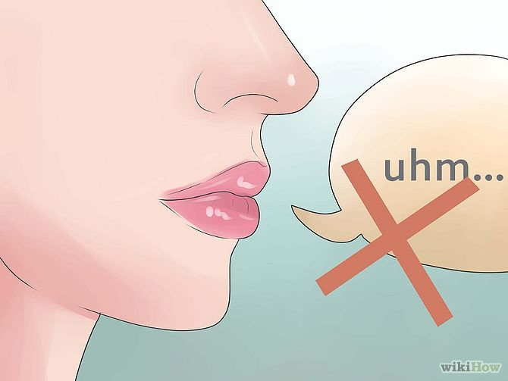
During personal interview
Speak clearly and confidently
Match the frequency

Slide 14
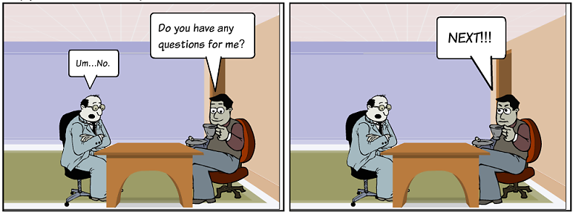
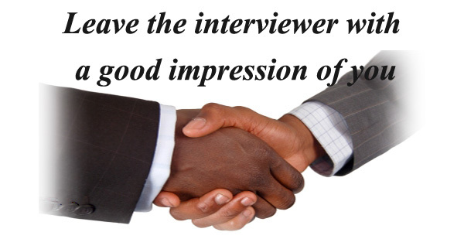
During personal interview
Ask questions and thanks to interviewer

